Slide 1

muHVT: Case based computational geometry modeling toolkit using R
Zubin Dowlaty, Sangeet Moy Das, Shubhra Prakash
July 2020

Slide 2
Agenda
The Enterprise Requirement for Complexity Science
A Point of View - Representation of a Complex System
Use Case: Intelligent Reporting
Demo

Slide 3
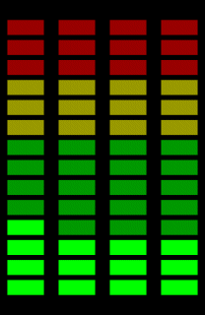
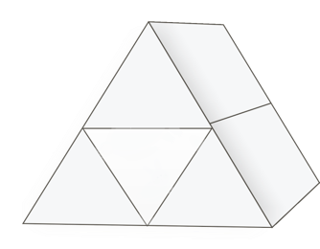



DIPP: Prescriptive Analytics, “what should we do”, “our best action”, ”evaluate this policy change”
Correct Perspective
Insights
Data
D
Descriptive
Analytics
I
P
D
I
P
P
Prescriptive
Analytics
P
Inquisitive
Analytics
Predictive
Analytics

Slide 4
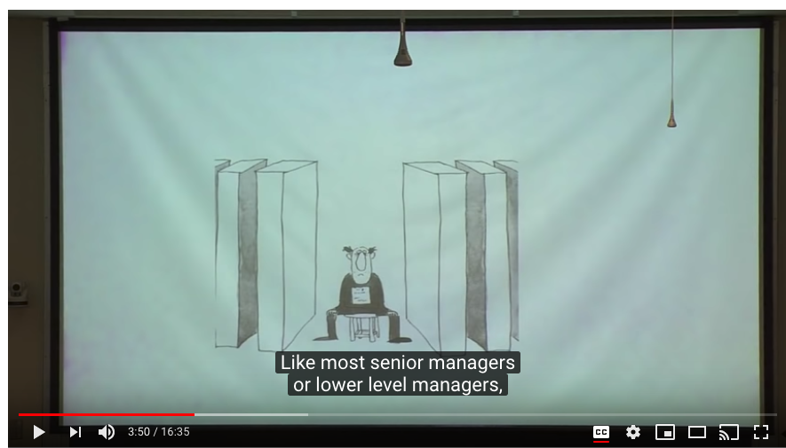
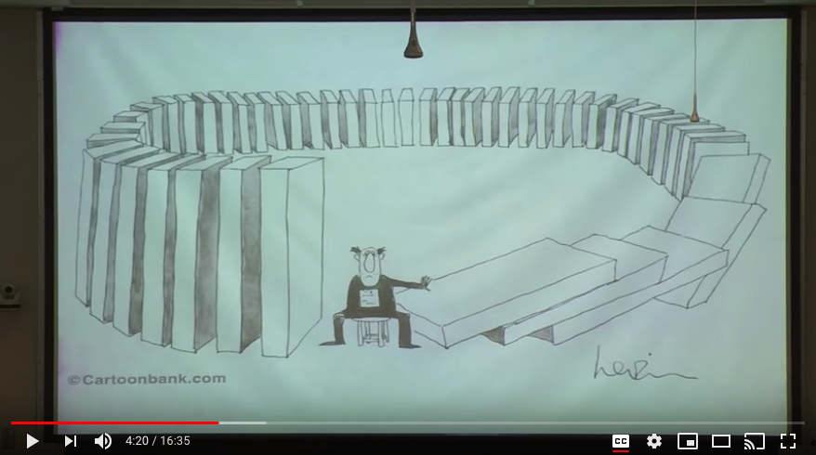
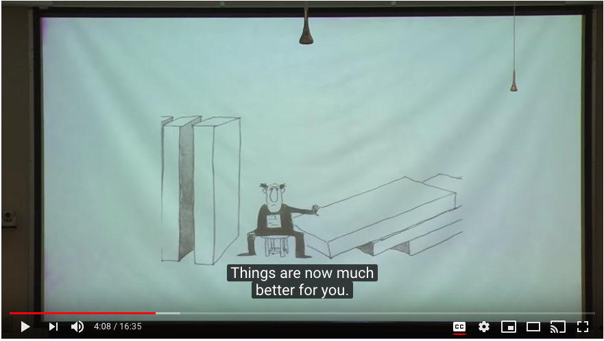
Why Prescriptive Analytics for the Enterprise?
Source: Cartoonbank.com

Slide 5
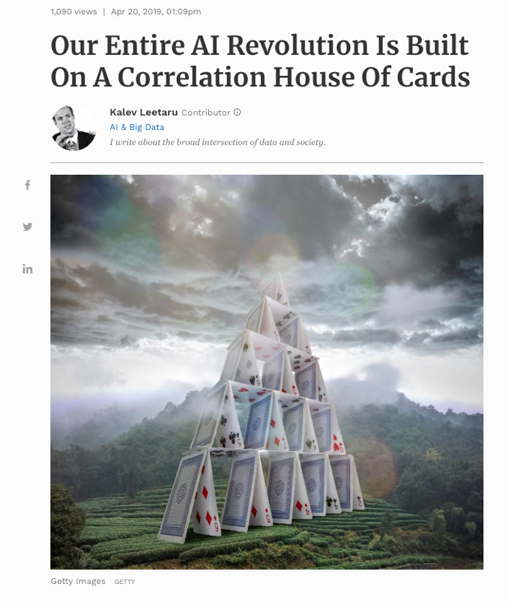
Default view in Decision Sciences: Comfortable.. But Deceiving
Mechanical View / Complicated Mindset
”Assembly Line”, rules and recipes on components
Complicated: Computer, Phone, Car, Rocket, Clocks
The classic Additive regression model: Y = a + B_{x1} + B_{x2}+ e
Are the systems we manage so tame?
Mandelbrot, “Clouds are not spheres, mountains are not cones”
The world is complex whether we like it or not – Get Real

Slide 6



Examples of Complex Systems Climate, Animals, Brains, Cells, Cities, Ecosystems, Supply Chains, Traffic, Economies, Firms & Customers Agents, Feedback, No Central Coordinator, Emergent, Self Organize, Learning

Slide 7
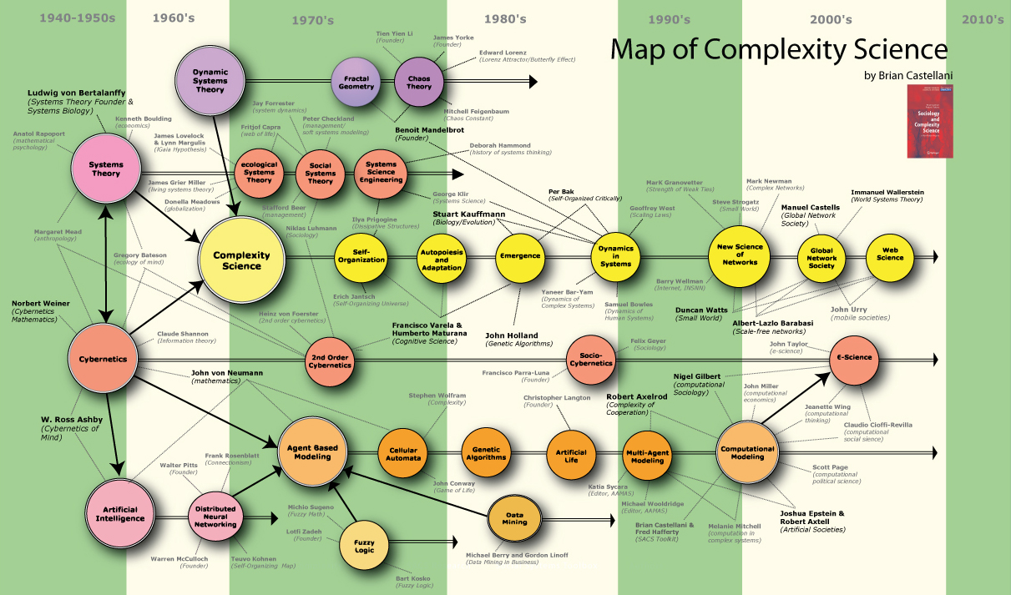
Complexity Science

Slide 8
First Principles: Complexity Science
Properties
Simple components or Agents (simple relative to the whole system)
Nonlinear Interactions among components usually caused by Feedback Loops
No central control
Emergent behaviors
Hierarchical(Layers) & Network design patterns
Information Processing
Dynamics: Study of continuing changing structure and behavior – STATES & Self Organization
Learning / Evolutionary / Adaptation
Study of Organisms (Ecology)
Computation model inspiration = Robotics (Sense, Plan, Act)

Slide 9
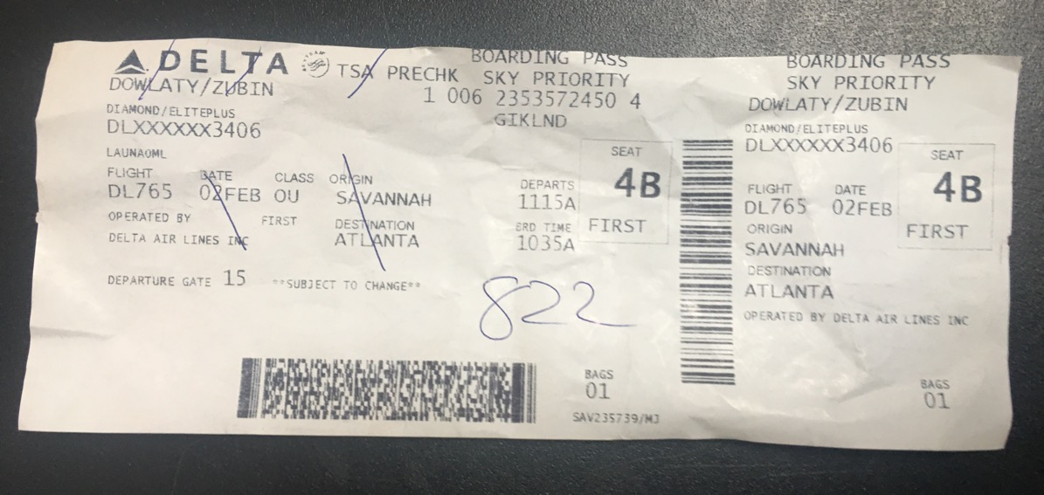
Use Case: Intelligent Reporting
Dealing with Networks (organism)
Possible Unanticipated Consequences and difficult to predict
Novelty Detection key characteristic
Shannon Entropy “Surprise”
Monitor at the case level, states and trajectories
Case = profile of a contextual set of inter-dependent variables, a situation of the case-object
Start with a Robust Sensing Apparatus
Visualize states and trajectories of the case-object
Robotics

Slide 10
Agenda
The Enterprise Requirement for Complexity Science
A Point of View - Representation of a Complex System
Use Case: Intelligent Reporting
Demo

Slide 11
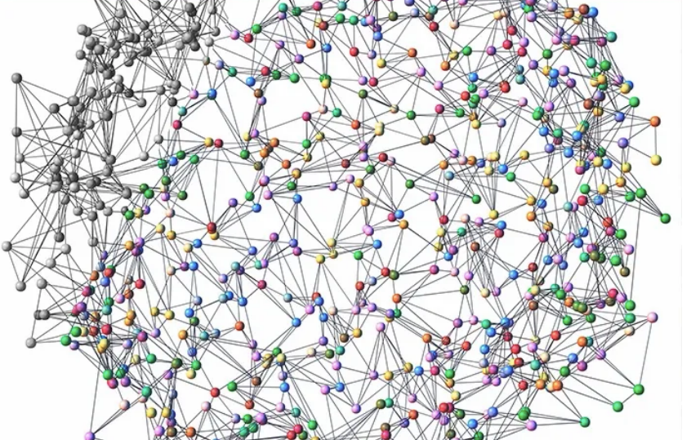
Why complex system representation an issue?
The intricate nature of complex systems currently poses great difficulty in an unsupervised representation across different domains
Some of these existing problems include:
Organized Simplicity
Disorganized Complexity
Organized Complexity
Now, how do we tackle these problems?

Slide 12
Emergence in a Complex System
"These new problems and the future of the world depends on many of them, requires science to make a third great advance, an advance that must be even greater than the nineteenth-century conquest of problems of organized simplicity of the twentieth-century victory over problems of disorganized complexity. Science must, over the next 50 years, learn to deal with these problems of organized complexity.”
- Warren Weaver, 1948
This is what emergence is all about; the overall effect of the interactions between all the components of the "organic whole"
These changing interaction leads to a dynamic emergent behavior over time

Slide 13
Case Based Modeling for a Complex System
Multiple behaviors emerge in a complex system
Behaviors are divided into discrete cases based on structural similarity giving a condensed representation of the system
The above process are repeated in a hierarchy for a microscopic view into the sub-behaviors of the system
This is achieved using the following techniques from our muHVT package on CRAN:
Unsupervised learning (Vector Quantization),
Computational geometry (Voronoi regions) and
Multi-dimensional scaling (Sammon's Projection)

Slide 14
Agenda
The Enterprise Requirement for Complexity Science
A Point of View - Representation of a Complex System
Use Case: Intelligent Reporting
Demo

Slide 15
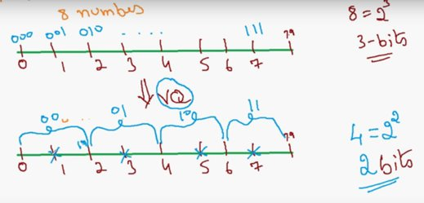
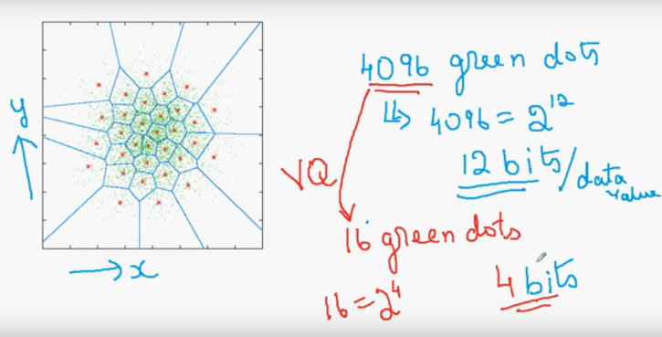
Vector Quantization
VQ on a 1D Number Line
Compression technique, tries to reduce the number of bits being used to encode the numbers
VQ on a 2D Plane
1. The plane above contains 4096 green dots which can be represented in 12 bits per data value
2. These 4096 dots have been replaced by 16 green dots which can be represented in 4 bits per data value

Slide 16
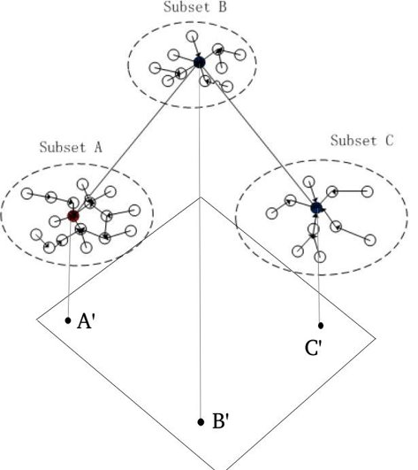
Dimensionality Reduction
Sammons projection
Projects points from a space of higher to lower dimensionality
Preserving the structure of inter-point distances in n-dimensional space.
Minimization of the error function involves distance between the points in original space and corresponding distance after projection

Slide 17
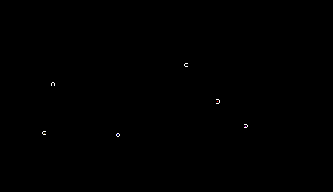
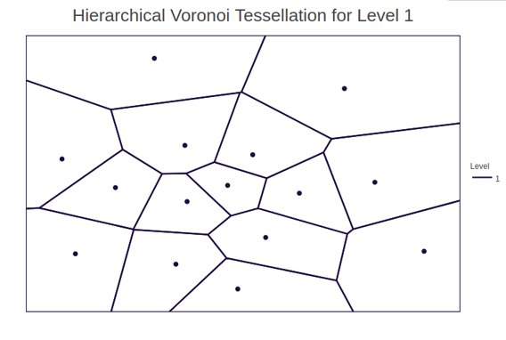
Voronoi Tessellations

Slide 18


Presence of geometric arrangements in nature

Slide 19
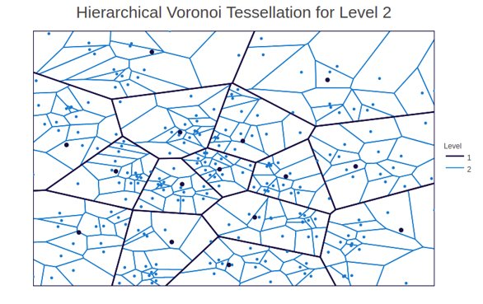
Hierarchical Voronoi Tessellations

Slide 20
Agenda
The Enterprise Requirement for Complexity Science
A Point of View - Representation of a Complex System
Use Case: Intelligent Reporting
Demo

Slide 21
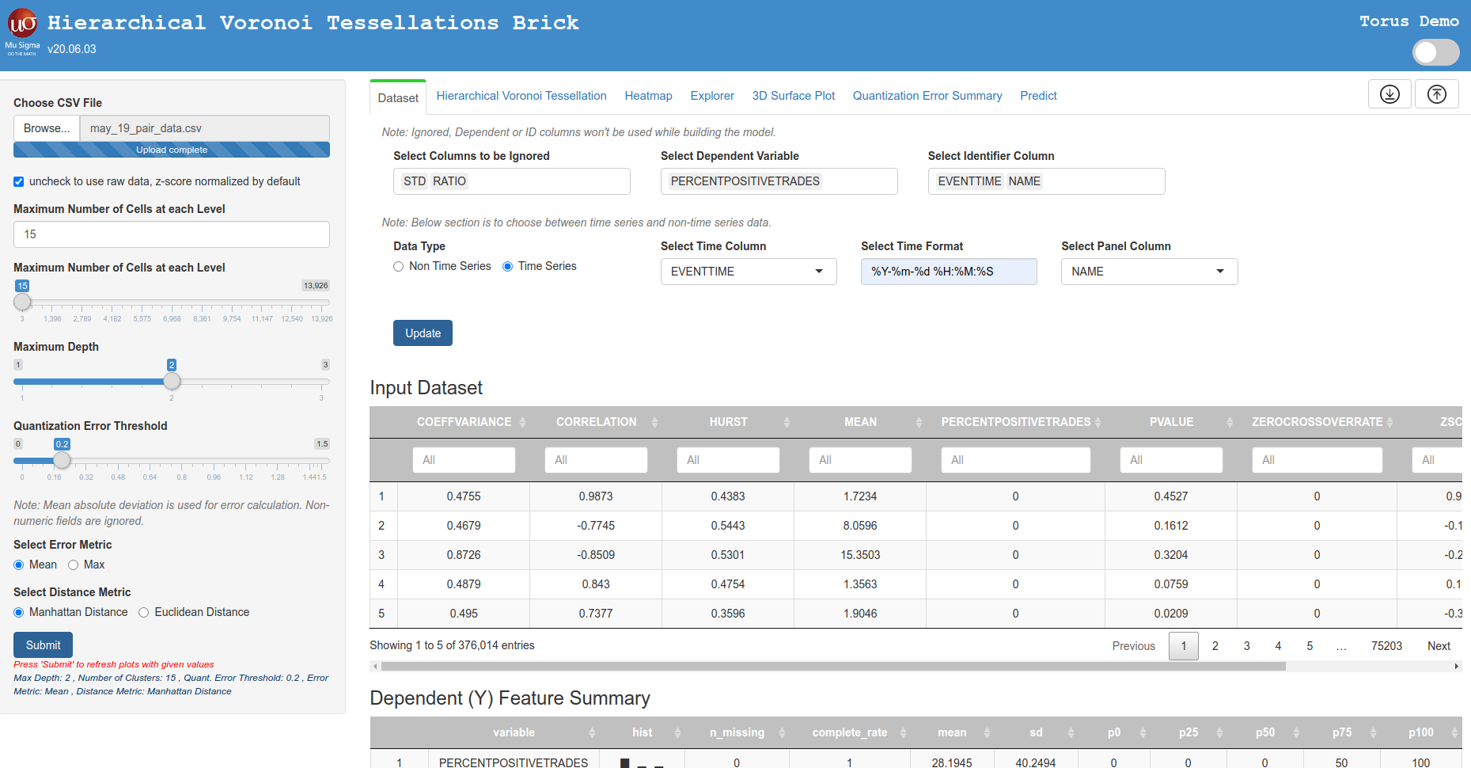
Shiny interface for muHVT

Slide 22
Thank you

